Slide 1
The Impacts of Carbon Emission on Human Development and Nature
CIS 568
Presented by
Arafat Ahamed Shaon

Slide 2
Key Motive
To get the geospatial visualization of the opposite impact of carbon (CO₂ ) emission on overall human development index (HDI) among different countries from 2010 to 2023.
The impact on the temperature on the same period.
The change on the Ozone layer on the stratosphere.
Data & Libraries
Data
CO₂ emission data
Human Development Index
Temperature anomalies
Stratospheric ozone concentration
Libraies
Pandas, Numpy, Plotly.express from Python
HTML, CSS, D3.js, svg.

Slide 3
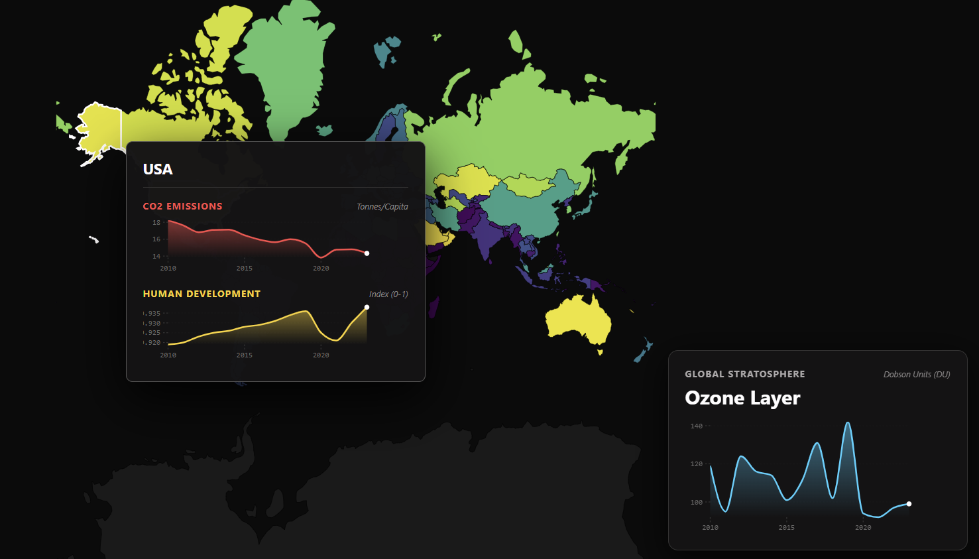
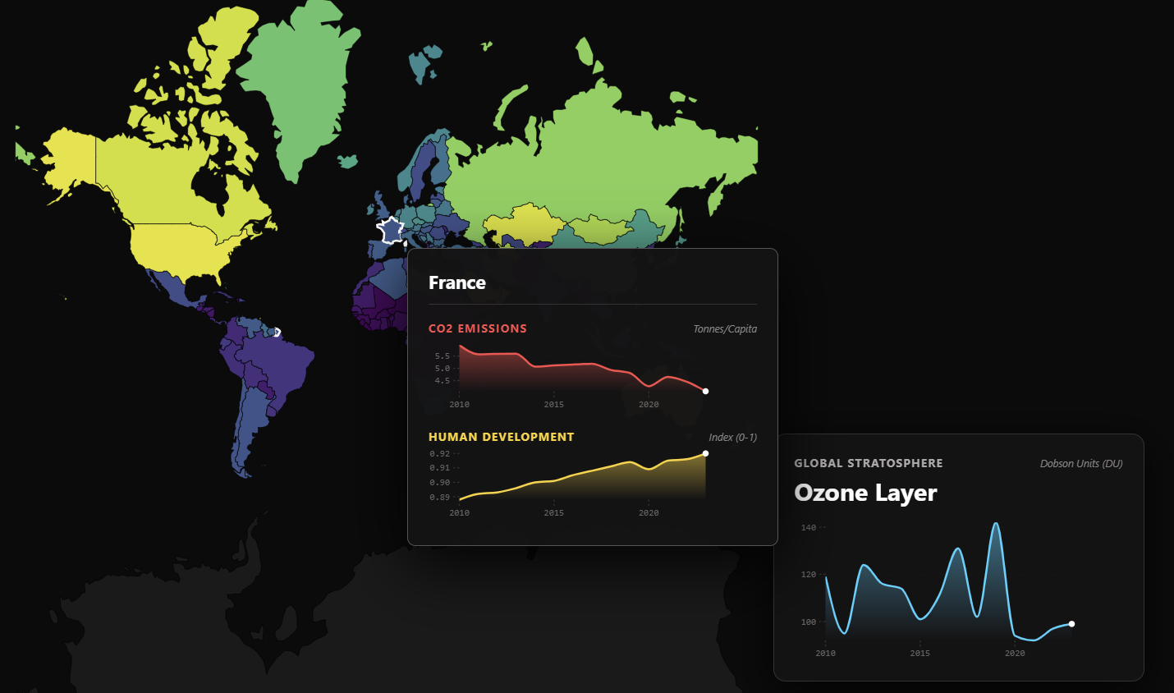
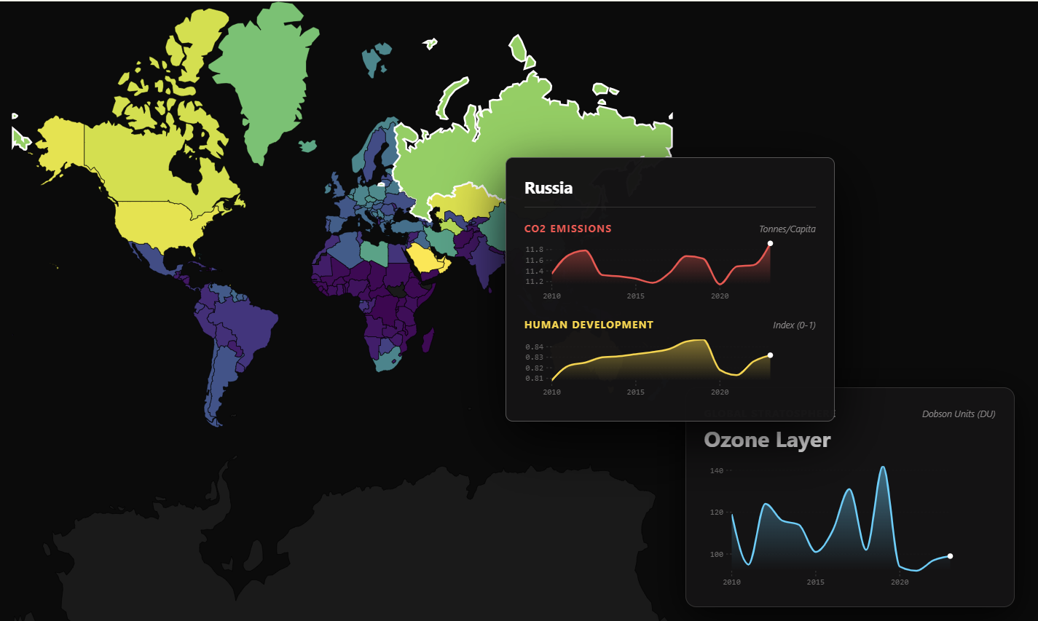
Output
Using the VS Code, I have got my interactive geospatial output where I can get the values as follows by hovering over different countries.

Slide 4
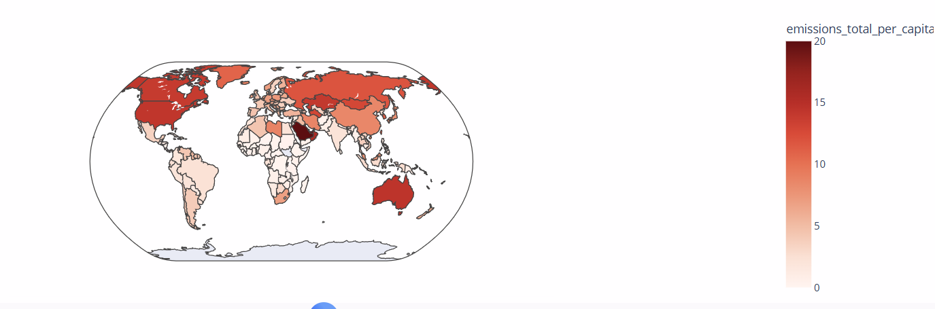
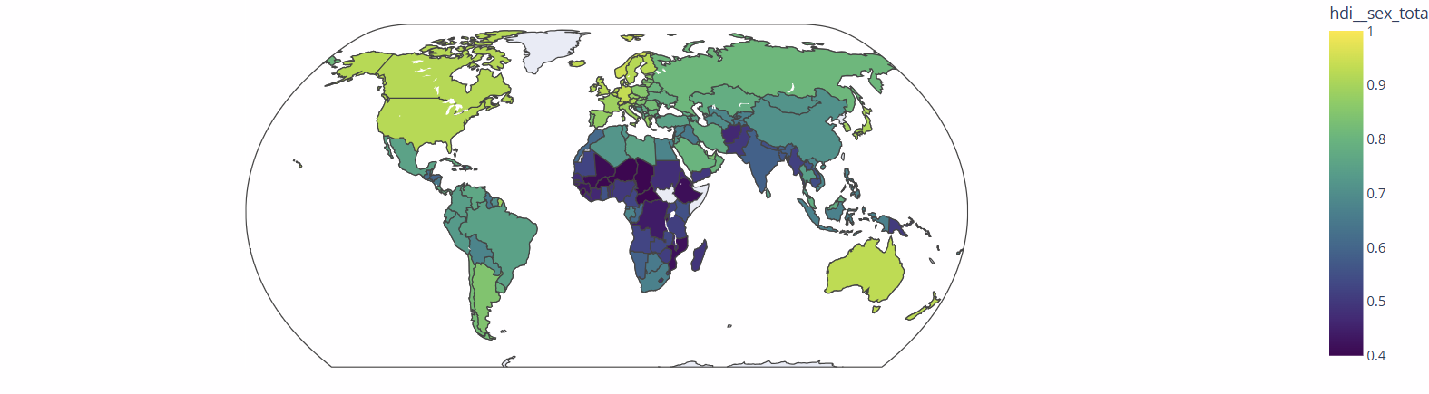
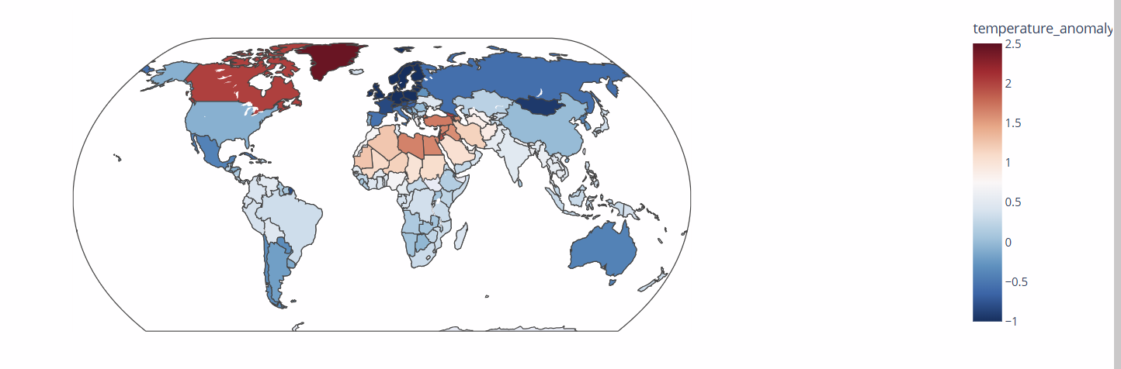
Output
To get more comprehensive visualization I used google Collab to get the visualization of the changes of carbon emission, HDI, and temperature through 2010 to 2023 among different countries. The outputs are as follows:
Carbon emission
HDI
Temperature

Slide 5
General Perspective
Due to the increase of the carbon emission life becomes harder, as people faces issues like:
Inadequate food production due to decreasing agricultural land.
Having health issues like respiratory infections, brain tissue damage, and increasing death rate,
Living below standard life
Decreasing birth rate and increasing death rate
Excessive heat wave and its consequences.

Slide 6
Findings & Conclusion
We have found that countries like : Canada, USA, Mexico, Brazil, Dominica, Check Republic, England, Sweden, France have shown the hypothetic relation in terms of the impact of carbon emission on the HDI.
On the other hand, the north-eastern part like: Russia, China, India, Kazakhstan have shown its opposite. Because we have seen a significant increase of HDI, along with the carbon emission rate in those region. That proves a point that, people in the north-east hemisphere are quite dependable on the usages of carbon on their daily basis.

Slide 7
Limitation
The data I have got for the ozone is a mean value data of ozone from 2010 to 2023 of the stratosphere. It is not country-based data.
If I could get a country based data of ozone from the stratosphere for each country we could get more relatable visualization of the impacts of carbon emission.
My plan is to mix the UV Index data with in this visualization. I believe I would get a comprehensive information about the impact of carbon emission.

Slide 8
THANK YOU

